Slide 1
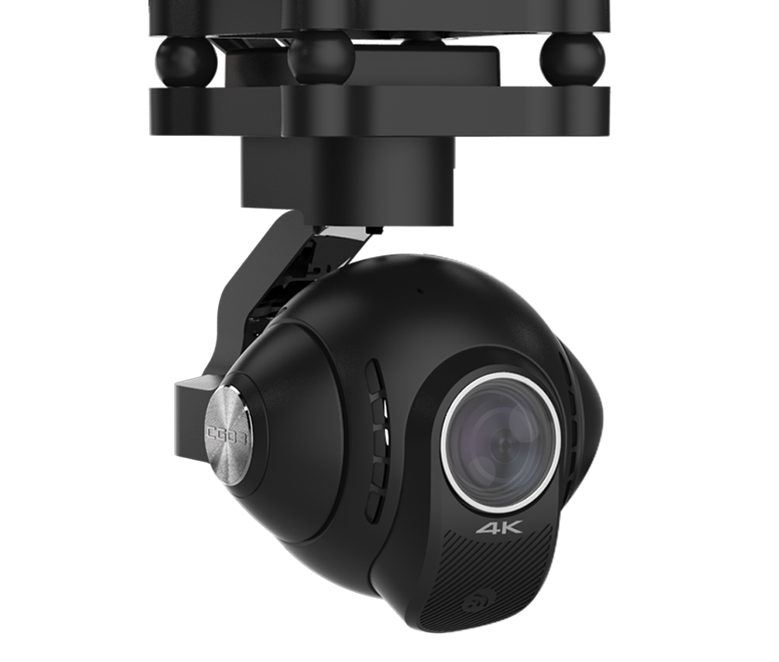
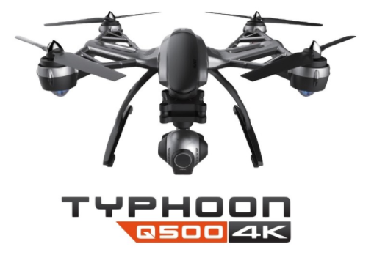
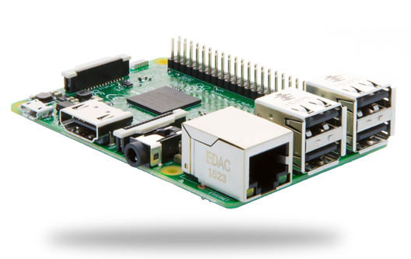
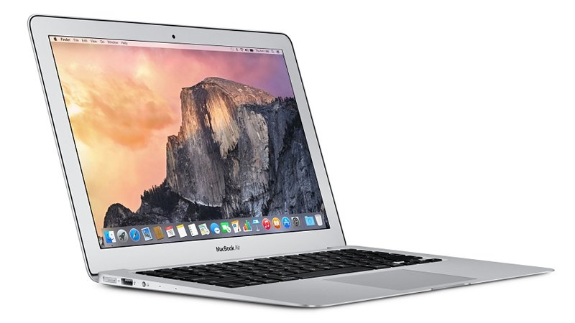
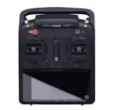
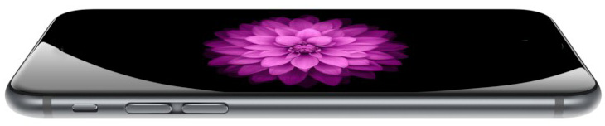

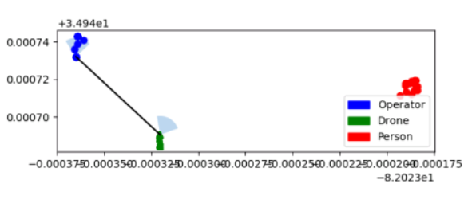
CG03
Q500
Request latest .jpg
RPi
UI.py
Pyplot Map
Object detections + Drone State
Object Log.txt
USB telem.
Drone position.txt
Operator position.txt
Lappy
ST10+
iPhone
Object DetectLive.py
App: SensorLog
App: VNC Viewer

Slide 2
Q500
CG03
Request latest .jpg
RPi
UI.py
Pyplot Map
iPhone.py
Operator position.txt
Lappy.py
Object Log.txt
Object detections + Drone State
Drone position.txt
Lappy
USB telem.
ST10+
iPhone
Object DetectLive.py
App: SensorLog
App: VNC Viewer

Slide 3
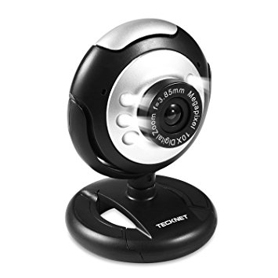
Webcam
Q500
RPi
UI.py
Pyplot Map
iPhone.py
Operator position.txt
CG03
Lappy.py
Object Log.txt
Request latest .jpg
Drone position
Send locations of objects
Lappy
iPhone
ST10+
Object DetectLive.py
App: SensorLog
App: VNC Viewer

